Slide 1
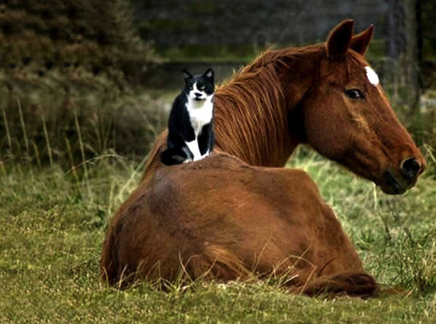
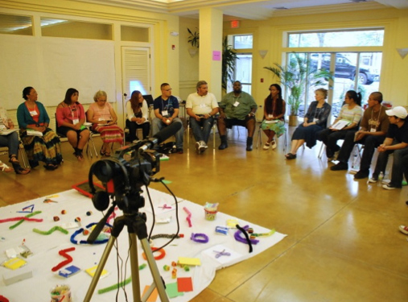
Enhancing Our Resilience
Through Leadership Embodiment & Peacemaking Circles
One Day Workshop June 20, 2015, 9:30 am – 6:00 pm $190.00
The Center at Westwoods 590 Gay Street, Westwood, MA 02090
Like animals, we have evolved to react when in danger as part of our survival. Yet, like this "cool" cat sitting calmly astride her equine friend, we, too, can learn to return to centered alignment and ease no matter how pressured we feel. When we are under pressure, pain or stress, instead of numbing out, or being overwhelmed, we can develop resilience through accessing these tools to better care for ourselves and others.
This self-care workshop will focus on how to access Centering and somatic empathy through:
Leadership Embodiment Centering of Wendy Palmer-listening deeply and responding with compassion, discernment, and resilience
Somatic Empathy-feeling into our embodied selves sensing from the inside out in relation to others rather than separating from our bodies or them
Concentration Practices-cultivating Mindful awareness and clearer thinking
Peacemaking Circles-listening and sharing from the heart without interruption
Medicine Wheel-Accessing Tribal Wisdom to bring ourselves back into wholehearted balance
Facilitators: Olivia Cheever, Ed.D., G.C.F.P.^{cm} Victor José Santana, M.A.
For more information and to register online visit: www.oliviacheever.com
Call Olivia at 781-449-1410 Call Victor at 857-445-9190
About Victor Victor José Santana is an educator, peacemaker, artist, community planner, curriculum developer, and youth leadership development specialist. www.victorjosesantana.com
About Olivia As a somatic Leadership Coach and Wellness Educator, Olivia Cheever teaches Self-care, Resilience, and Peacemaking through accessing our powerful Mindful healing resources, Centering, Somatic Empathy, and Feldenkrais® “gourmet” movements.
“We inhabit a body that communicates and processes information on a sensory level far more encompassing than our cultural view leads us to believe.” –Wendy Palmer Founder of Leadership Embodiment
"With our thoughts we make our world. Our mind is centered and precedes our deeds. Speak or act with your pure mind and happiness will follow you like a shadow that never leaves." —HH. The Dalai Lama: Prayer for US Senate, March 4, 2014

